Slide 1
Descriptive Statistics
Summarizing Data Numerically

Slide 2
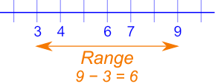
Describing Data: Range
How might we describe a data series?
Maximum: The largest number in the series
Minimum: The smallest number in the series
Range: The distance between the maximum and minimum values in the series
Example: Series = (1,2,3,4,5)
Maximum = 5
Minimum = 1
Range = 4

Slide 3
Descriptive Statistics - Measures of Central Tendency, aka Averages
Describes where on the number line a series is centered
There are several different types of average / definitions of “center”

Slide 4
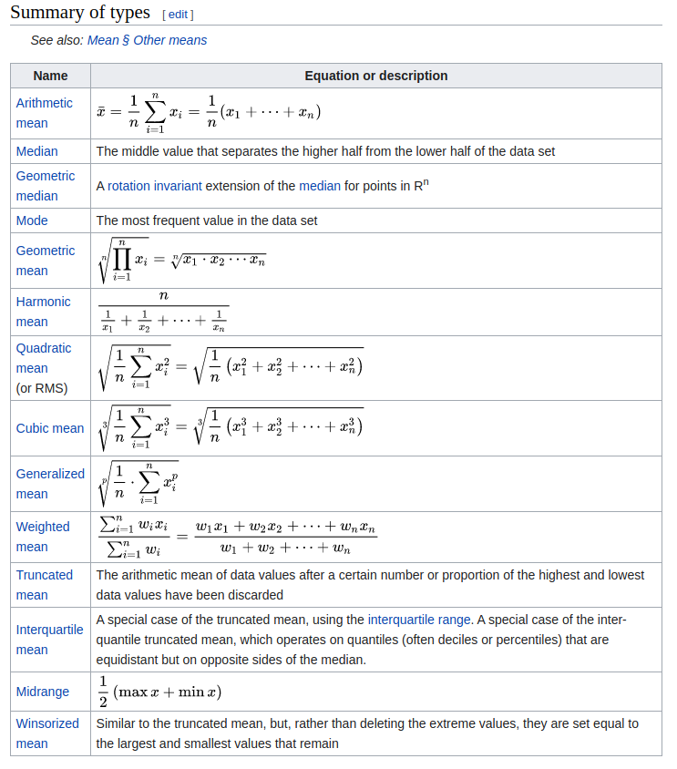
Averages!

Slide 5

Arithmetic Mean
Add all values in the series, then divide by the number of values in the series
Series = 1, 2, 3, 4, 5
Sum of series = 1 + 2 + 3 + 4 + 5 = 15
Length of series = 5
15 / 5 = 3
Fact: The average human being has less than two arms

Slide 6
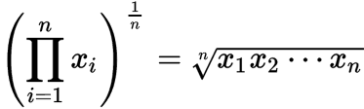
Geometric Mean
Geometric mean: The “n’th” root of the product of all values in a series
Series = (1, 2, 3, 4, 5)
1 * 2 * 3 * 4 * 5 = 120
Take the 5th root of 120 to get a geometric mean of 2.605
Why / when use the geometric mean?
When data exhibits compounding and/or exponential growth (among other reasons)

Slide 7
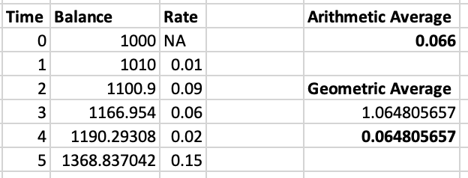
Geometric Mean
Assume an investment of $1,000 for 5 years. Your interest rates for each year are 1%, 9%, 6%, 2%, and 15% (in that order)
Total after 5 years: $1,368.84
Calculator using arithmetic mean: 1,376.53
Calculator using geometric mean: 1,363.67
Using the geometric mean our estimate is 5.16 short, while using the arithmetic mean, the estimate is 7.69 over
Geometric mean wins!

Slide 8
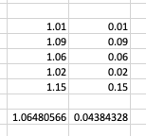
Geometric Mean
Assume an investment of $1,000 for 5 years. Your interest rates for each year are 1%, 9%, 6%, 2%, and 15% (in that order)
=geomean()
Add one to the percent or you’ll get the wrong answers

Slide 9
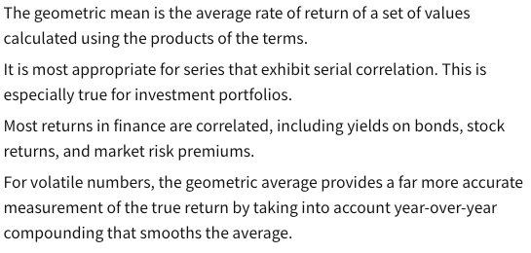
When to use the geometric mean - continued

Slide 10

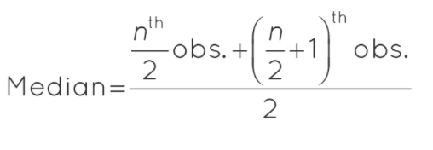
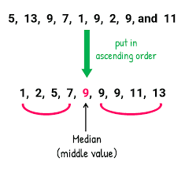
Median
Median: The midpoint in an ordered series
Series = 5, 1, 3, 2, 4
Ordered series = 1, 2, 3, 4, 5
Median = 3
When even, take the mean of the two middle values
1, 2, 3, 4, 5, 6
Median = (3 + 4) / 2

Slide 11
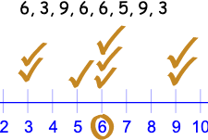
Mode
Mode: The most frequently occurring value in a series
Series = (0, 1, 2, 3, 4, 5)
Mode = N/A
Series = (0, 1, 1, 3, 4)
Mode = 1
Series = (0, 0, 1, 1, 3, 4, 5)
Mode = 0 and 1, making this “bimodal”

Slide 12
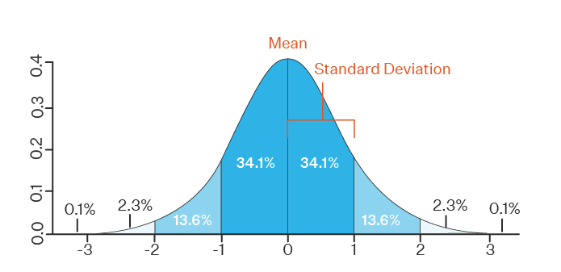
Measures of Dispersion / Spread
Variance
Standard deviation

Slide 13
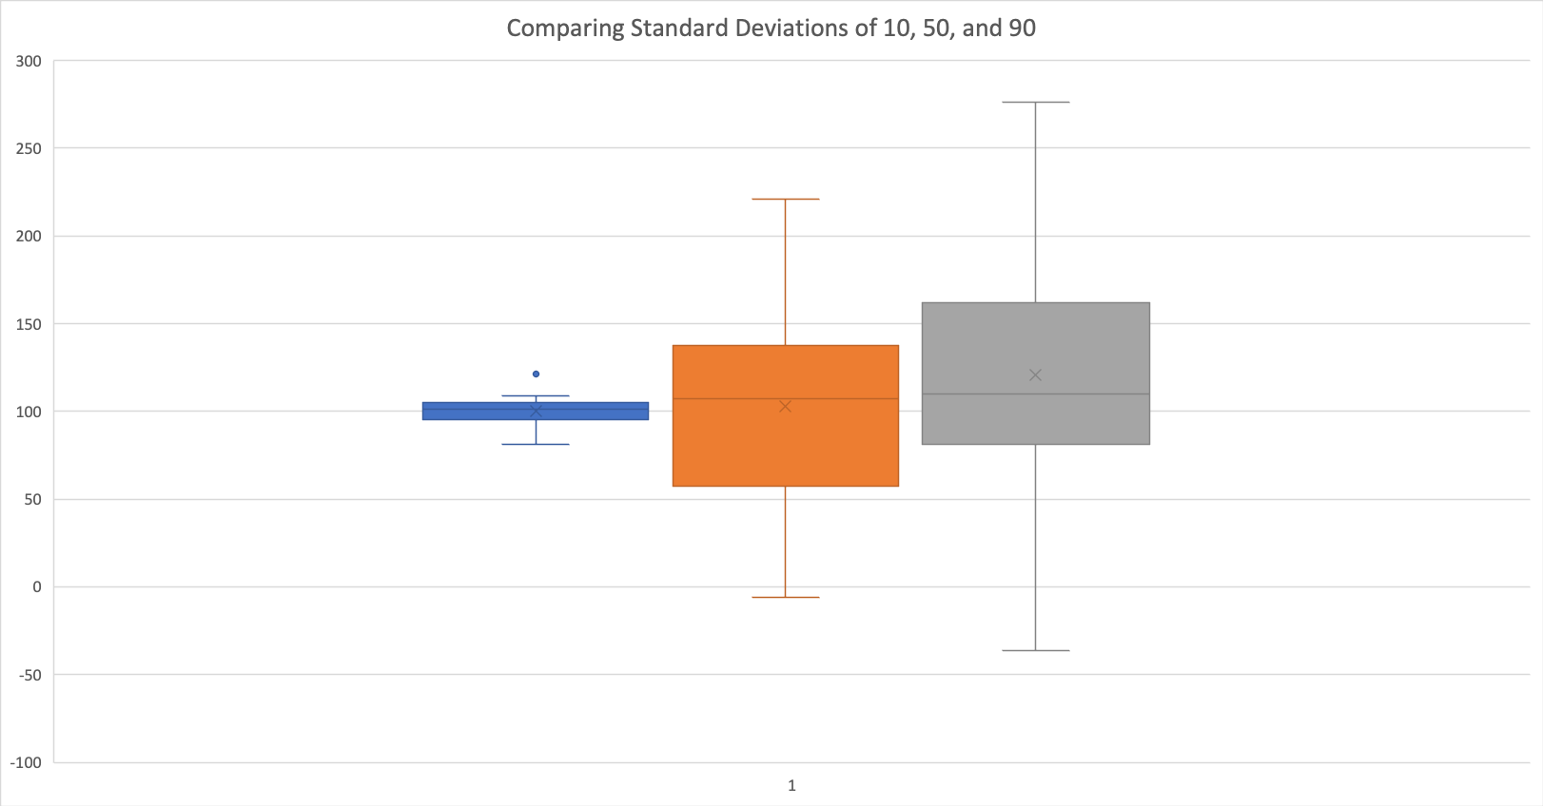
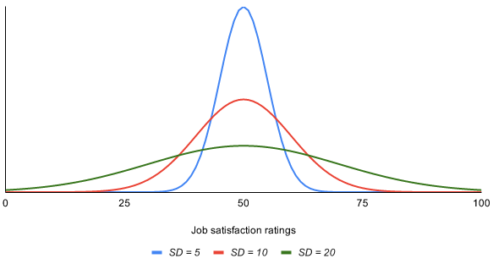
Measures of Dispersion / Spread
Variance
Standard deviation

Slide 14

Measures of Dispersion / Spread: Variance
Series = (1, 2, 3, 4, 5, 6, 7)
Mean = 4
Subtract the mean from each x-value and square the product
(1-4)^2 + (2-4)^2 + (3-4)^2….
Add up the squared products
Divide the sum of the squared products by N if the variance is being calculated for a population
Divide the sum of the squared products by n -1 if the variance is being calculated for a sample

Slide 15
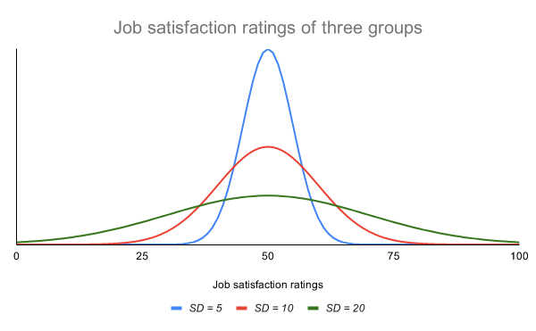
Measures of Dispersion: Standard Deviation
Take the square-root of variance to find the standard deviation of a series
Better than variance because it is scaled in the original series’ units, not units squared
Standardized so that spread and extremeness can be compared between series / samples

Slide 16
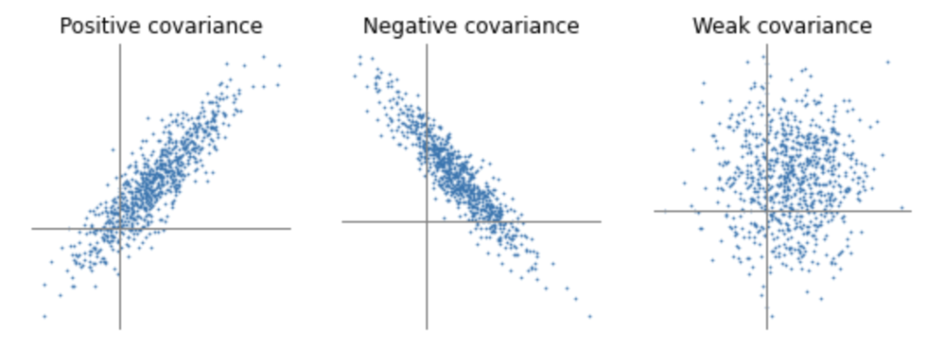
Measures of Association: Covariance
Measures how two variables move together
Difficult to interpret, so use correlation instead

Slide 17


Covariance
Steps:
Calculate means of x and y
Subtract the mean of each variable from each observation
Multiply each x-xbar by each y-ybar
Sum the products
Divide by the number of observations if population, or n-1 if a sample

Slide 18
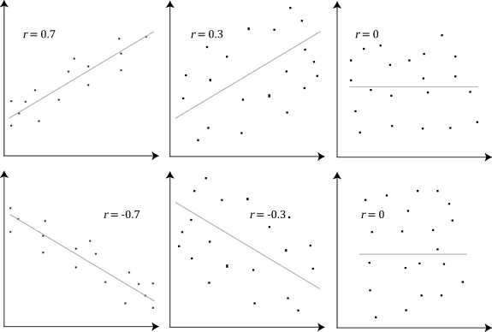
Measures of Association: Correlation
Ranges between -1 and 1
1 = Perfect positive correlation (upward sloping)
0 = No correlation
-1 = Perfect negative correlation (downward sloping)
Standardized, so units allow comparisons

Slide 19


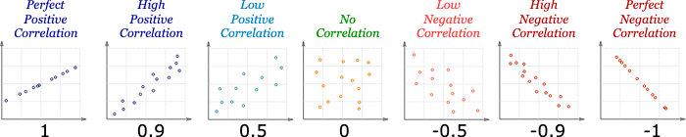

Slide 20
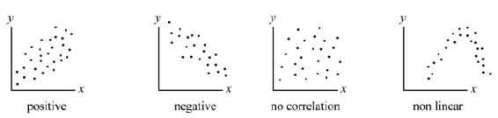
Correlation Doesn’t Work When Non-Linear

Slide 21
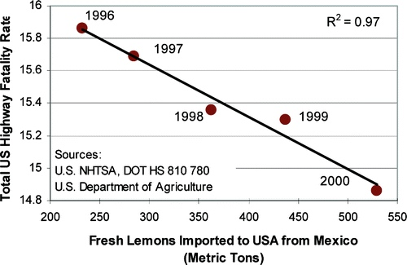
Causality and Spurious Correlation
Importing lemons from Mexico saves American lives on the highway!
Two sets of data may resemble one another for lots of reasons
Often hard to resist attributing causality
People will find patterns even if they aren't there!

Slide 22
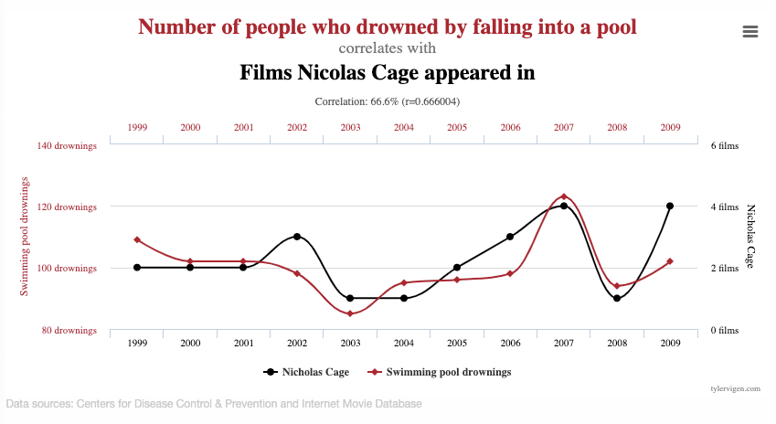

Slide 23
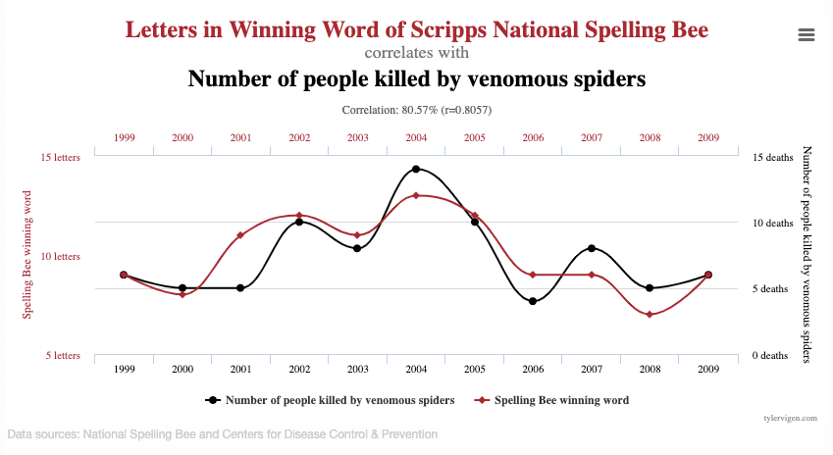

Slide 24
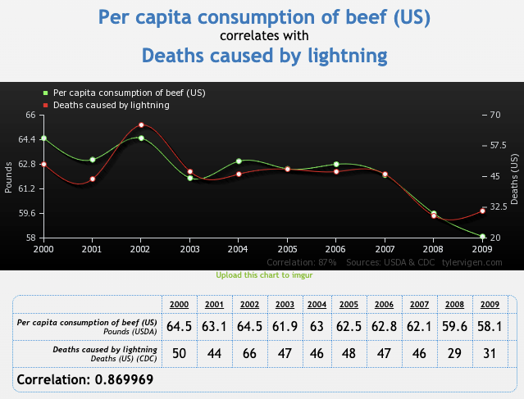

Slide 25
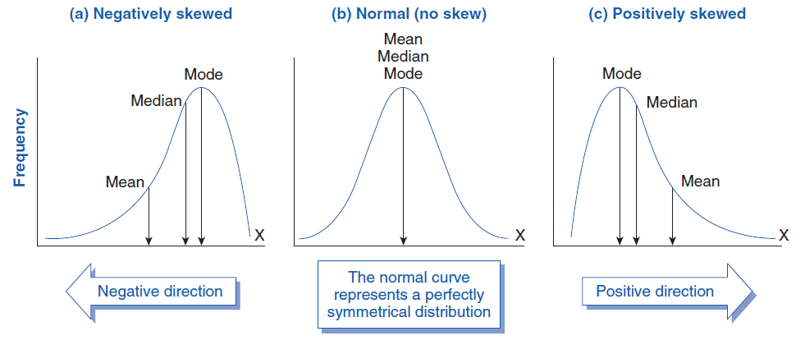
Skew

Slide 26
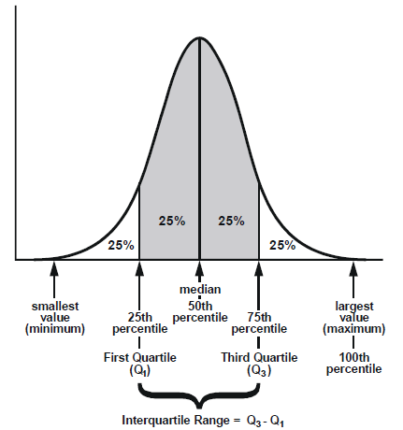
Quantiles
Split the data into equal sized groups
Quartiles = Data split into four groups
Quintiles = Data split into five groups
Of 500 data points, the lowest 0-1/5 are in the 1st quintile and the top 4/5-5/5 are in the 5th quintile
Interquartile range: The range between the 75th and 25th percentiles (3rd and 1st quartiles)

Slide 27
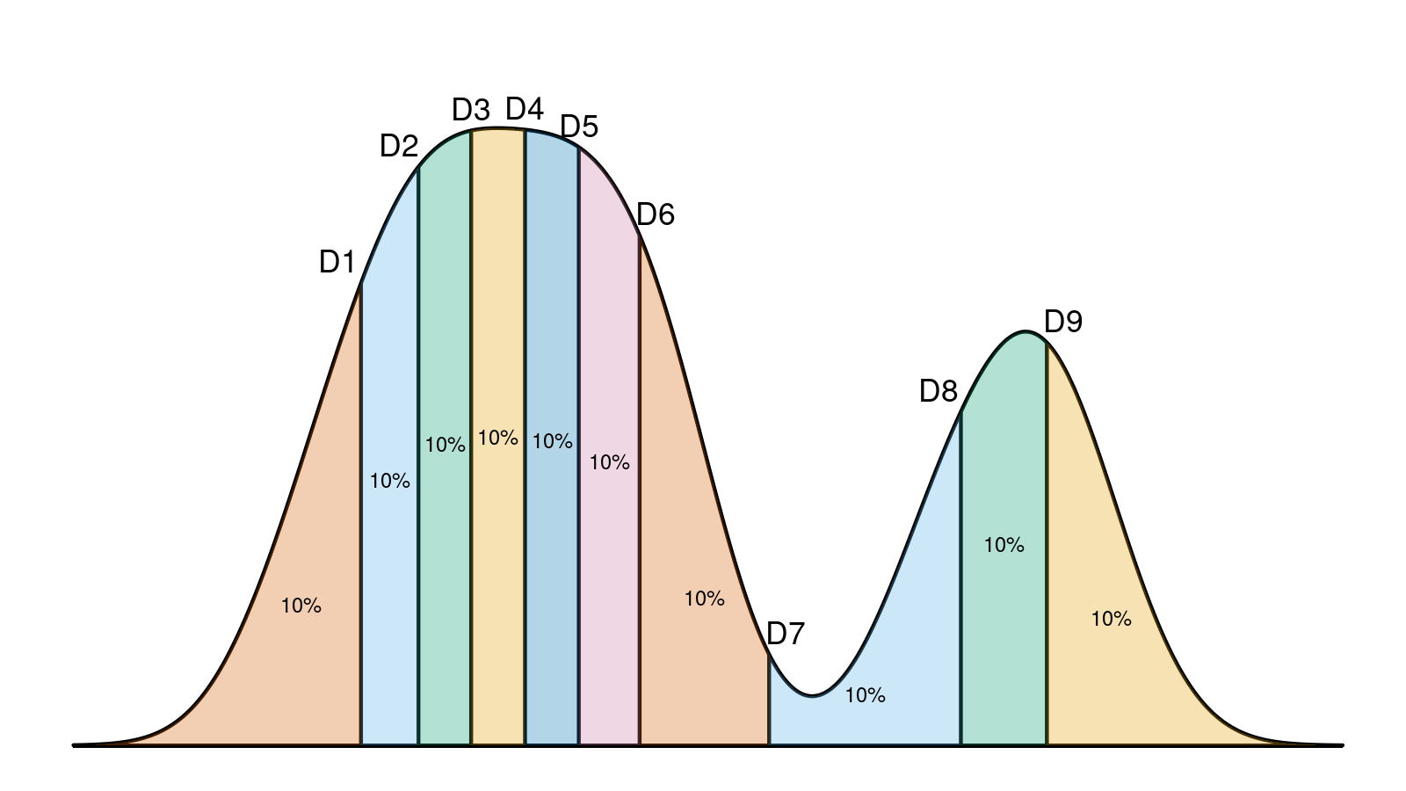
Quantiles with 10 Categories = Deciles

Slide 28
Types of Data
Qualitative - Values are not numbers
Categorical (Unordered) - Color, flavor, name, etc
Ordinal (Ordered) - Rank, grades, etc.
Quantitative - Values are numbers
Continuous - Miles per hour, inches, gallons, etc
Discrete - Students per class, Cars per row, etc.

Slide 29
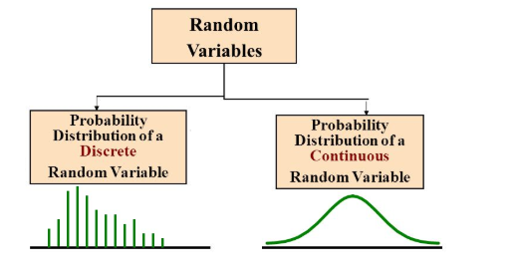
Types of Data

Slide 30
Frequency & Relative Frequency
Frequency = count
Relative frequency = count / total
Cumulative frequency*
Grade | Frequency | Relative Frequency
A | 3 | 3/19
B | 9 | 9/19
C | 7 | 7/19
Total | 19 | 19/19

Slide 31
Cumulative Frequency
Cumulative Frequency:
The running total of relative frequencies, either ascending or descending across series range
Grade | Frequency | Cumulative Frequency (Low to High) | Cumulative Frequency (High to Low)
A | 3 | <=A, 19/19 | >= A, 3/19
B | 9 | <=B, 16/19 | >=B, 12/19
C | 7 | <=C, 7/19 | >=C, 19/19
Total | 19

Slide 32
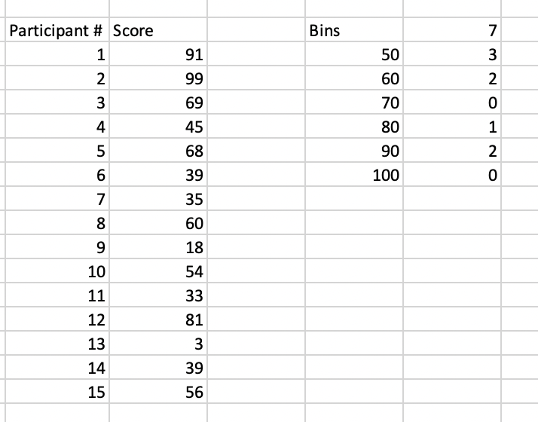
=frequency(Values,Bins)
Create an array of bins / categories
Values = data to be tabulated
Bins = your chosen array of bins
Output comes as a table with one additional bin for values not captured in set of arrays (in my example, the added category is <50)

Slide 33
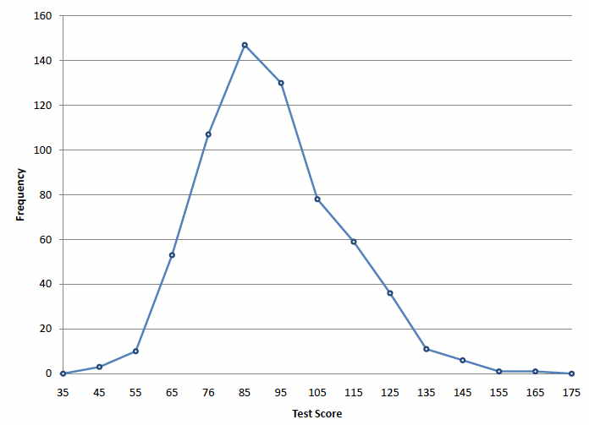
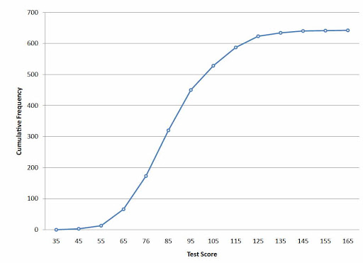
Relative & Cumulative Frequency

Slide 34
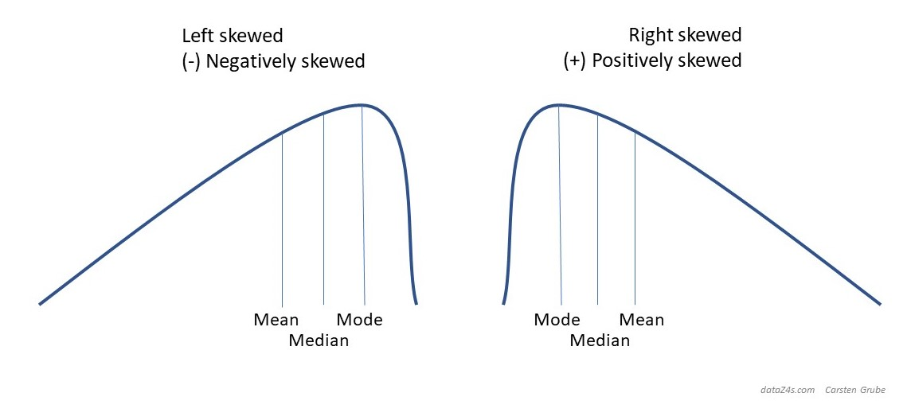
Skew
Asymmetry
Left / negative skew: Mean < Median
Right / positive skew: Mean > Median

Slide 35
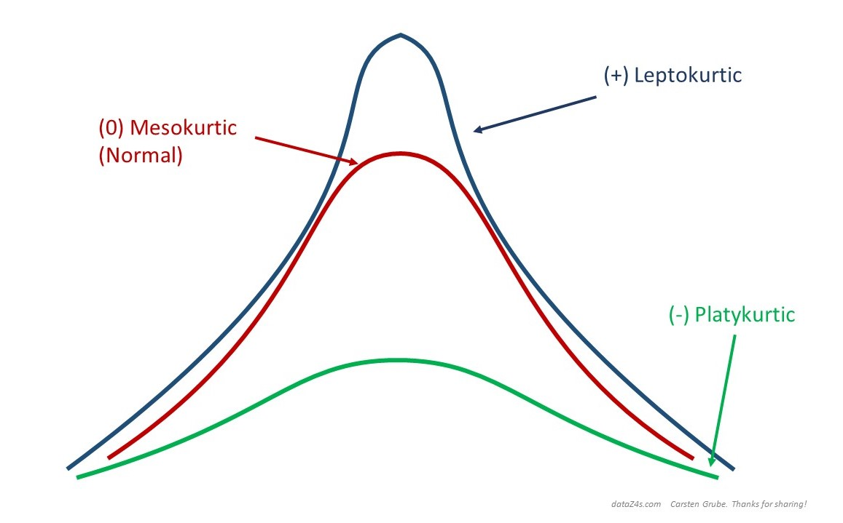
Kurtosis
Kurtosis describes “peakedness” and frequency of extremes, also known as heaviness of tails

Slide 36
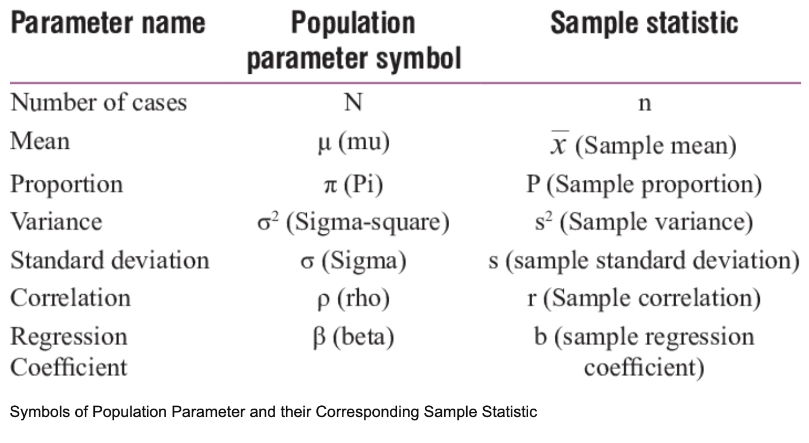

Slide 37
Frequency Distributions
Relative, aka Percentage, aka Frequency = Count / Total
Bins = k, where 2^k > n
“In practice, the number of classes and the appropriate class width are determined by trial and error”
Bin / Class width = (max number - min number) / k (k = number of classes / bins)
“Ultimately, one should use trial and error and judgment to determine the combination of the number of classes and class width that provides the best frequency distribution for summarizing the data”

Slide 38
Constructing Frequency Distribution
Without a pre-existing reason for choosing a number of bins (such as the example using predetermined grade ranges) How many non-overlapping classes (bins) do we need to represent our data well?
2^k rule: Find minimum whole number (k) that allows for the equation 2^k > n, where n is the sample size
2^k means two raised to the power of another whole number, k
If k = 3, we get 2^3 or 2*2*2 = 8
Class width = (maximum value - minimum value) / k
Class limits: Cutoff points between classes (bins)
Class midpoint = (Upper limit + lower limit) / 2
(59 + 50) / 2 = 54.5

Slide 39
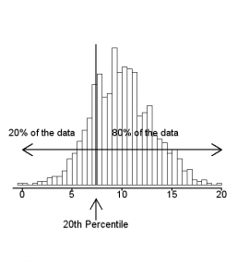
Percentiles
Measures spread from highest to lowest
The value below which a percentage of the data falls
20 people race and you come in 4th
4 / 20 = .2 =
(1 - .2) = .8
80th percentile = Faster than 80% of the racers
Be sure to order data
=frequency()

Slide 40
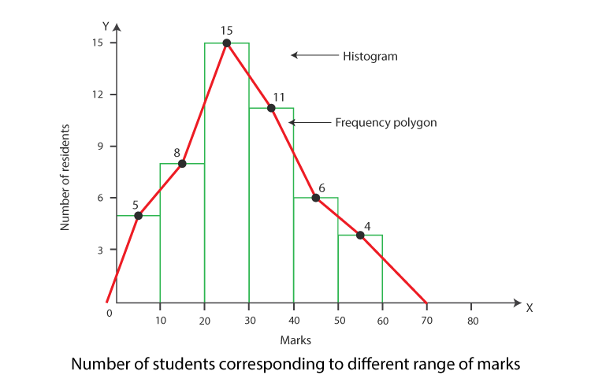
Frequency Polygon
Draw line to connect histogram bin midpoints
“Density plot / curve” when smoothed out

Slide 41
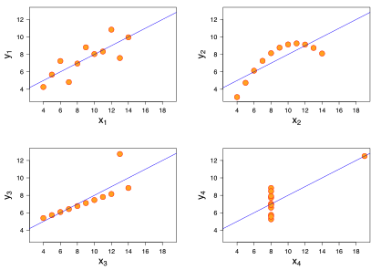
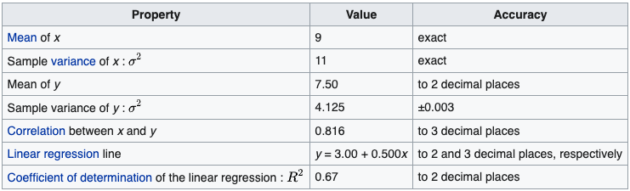
Descriptive Statistics Pitfall Alert
Which graph is are the summary statistics describing?

Slide 42
ALL OF THEM!

Slide 43
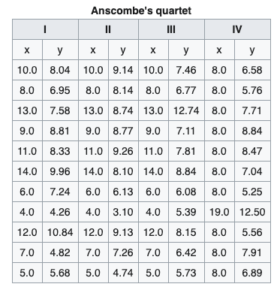
Anscombe's Quartet

Slide 44
Excel Functions
Mean | =average()
Median | =median()
Mode (if one exists) | =mode()
Variance for population / sample | =var.p() / =var.s()
Standard deviation for population / sample | =stdev.p() / =stdev.s()
Covariance for population / sample | =covariance.p(x,y) / =covariance.s(x,y)
Correlation | =correl(X,Y)
Count | =count()

Slide 45
Excel Functions
Largest number | =max()
Smallest number | =min()
Frequency of each value | =frequency()
Square root | =sqrt()
Random Data from 0 to 1 (Uniform Distribution) | =rand()
Random Data from A to B (Uniform Distribution) | =randbetween(A,B)
Random data with a mean of A and a standard deviation of B (normally distributed) | =norm.inv(rand(),A,B))

